Slide 1
Module 1: The New Windows UI Design Solution
Notes:
Windows, Bing, PowerPoint, Internet Explorer, Visual Studio, WebMatrix, DreamSpark, and Silverlight are either registered trademarks or trademarks of Microsoft Corporation in the United States and/or other countries. Other product and company names mentioned herein may be the trademarks of their respective owners.
The example companies, organizations, products, domain names, e-mail addresses, logos, people, places, and events depicted herein are fictitious. No association with any real company, organization, product, domain name, e-mail address, logo, person, place, or event is intended or should be inferred.
The information contained in this tutorial is provided without any express, statutory, or implied warranties. Neither the authors, Microsoft Corporation, nor its resellers or distributors will be held liable for any damages caused or alleged to be caused either directly or indirectly by this tutorial.
Copyright 2012 by Microsoft Corporation.

Slide 2
This presentation covers:
Locating and installing applications
Concepts behind new Windows UI style applications
Overview of the important components in Windows 8 applications

Slide 3
Download these apps for this module
This module uses two apps: Photos and Puzzletouch
Locate these apps in the Store: Instructions for searching within the store are in the written module

Slide 4
Concepts behind new Windows UI style applications
New Windows UI is the code name for Microsoft’s design language. It’s rooted in modern, Swiss design which emerged from Switzerland in the 1550s. Swiss design has an emphasis on:
Reduction
Cleanliness
Readability
Simple and beautiful visuals

Slide 5
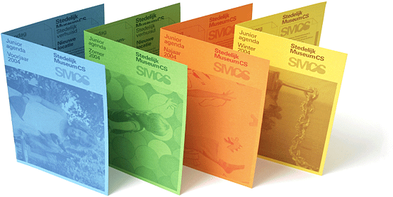
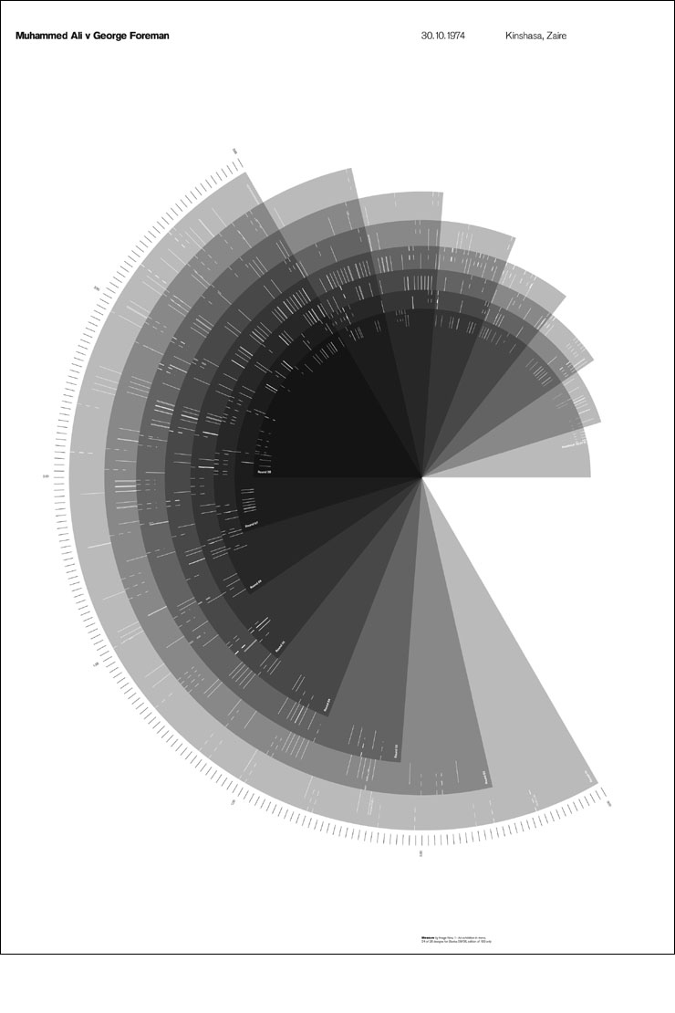
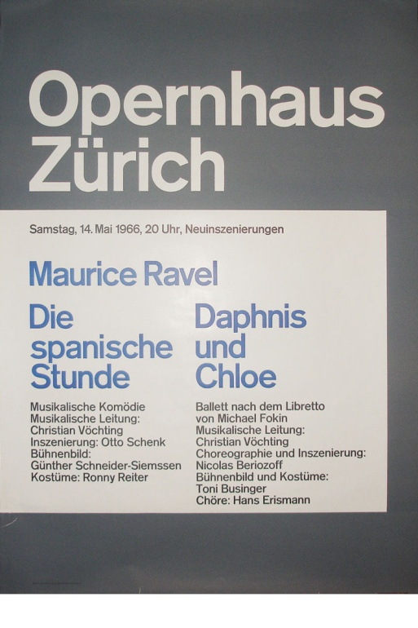
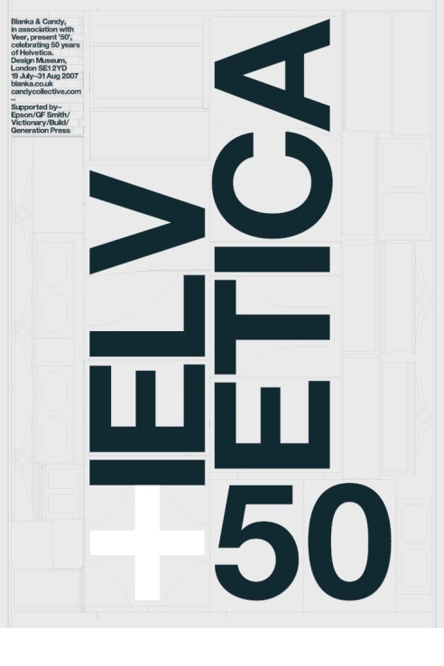

Slide 6
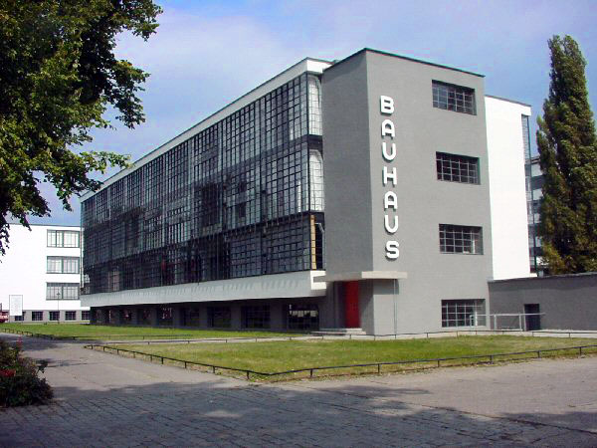
Other influences
Bauhaus was a school in Germany that combined crafts and the fine arts, and was famous for the approach to design that it publicized and taught. It operated from 1919 to 1933.

Slide 7



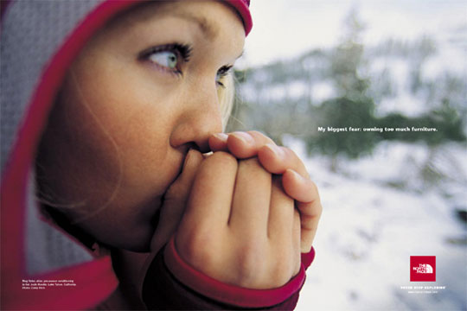
Other influences
The International Typographic Style emphasizes cleanliness, readability and objectivity. Strong use of a grid, sans-serif typefaces, and flush-left, ragged-right text. The style is also associated with a preference for photography in place of illustrations or drawings.

Slide 8
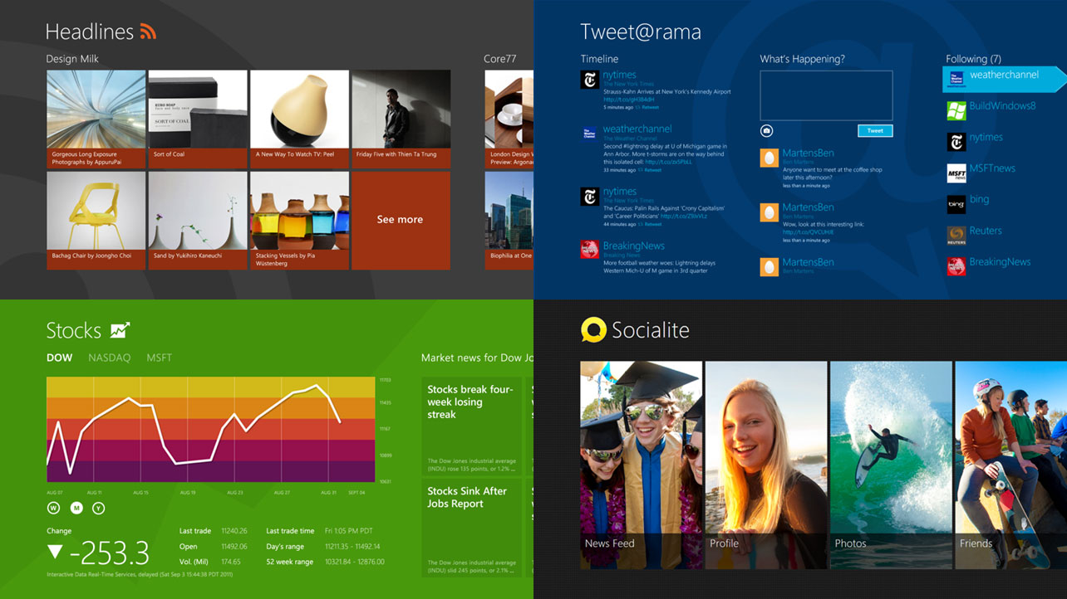
Influences reflected in new Windows UI style apps

Slide 9
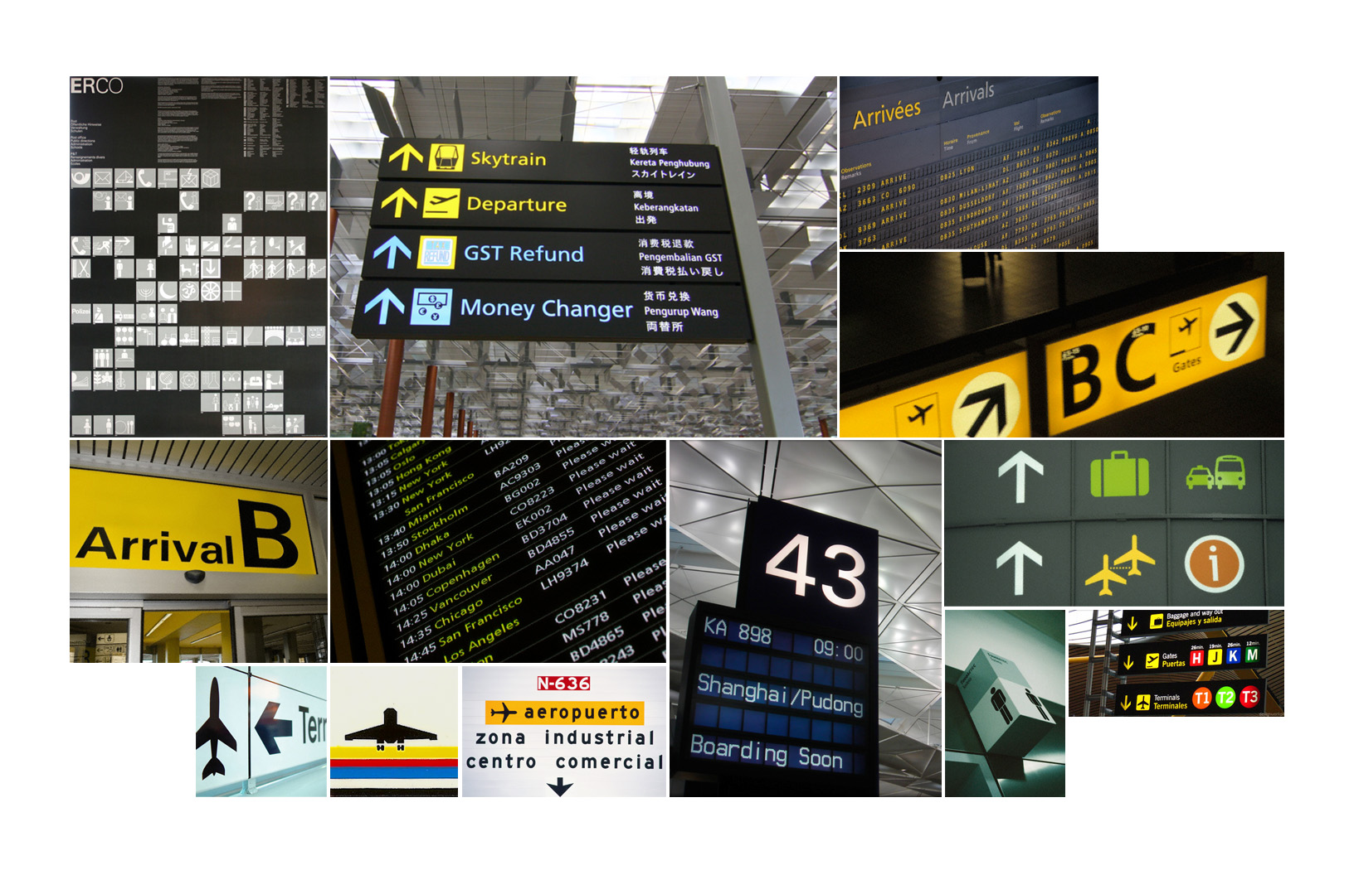
Designed on concept of travel signage

Slide 10

Text and imagery in clear structured manner
Notes:
The Finance app uses text and imagery in a structured, clear manner.

Slide 11
Windows 8 application components include
Canvas
Charms for Search, Share, Settings, and Devices
Touch language for interactions
App bar for commanding

Slide 12
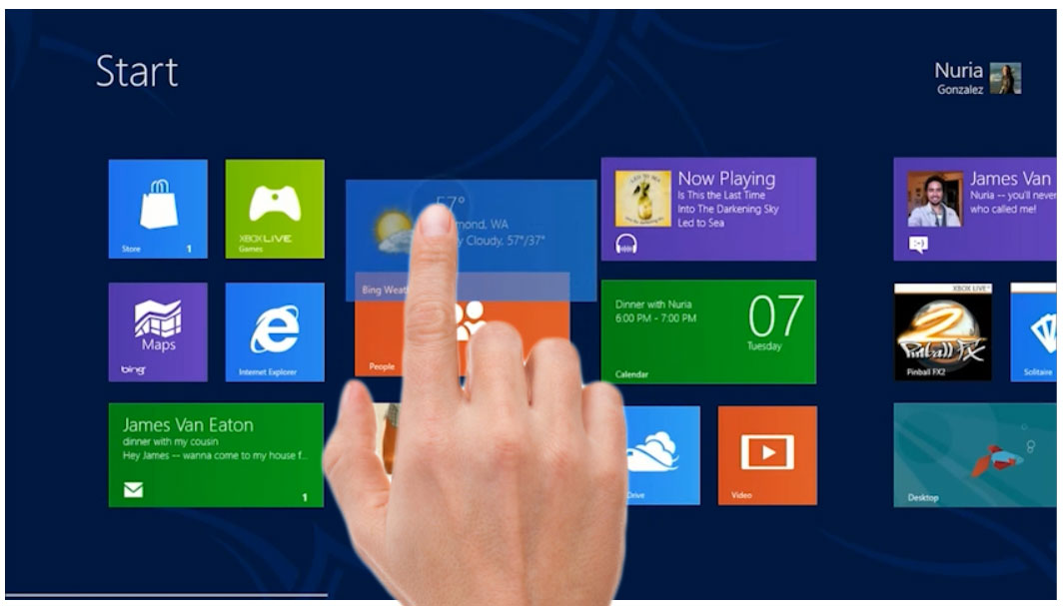
Canvas: The surface of a device
In Windows 8, users are able to complete core scenarios, such as launching applications, searching, sharing and navigating the content of their system just by using the canvas. In the perfect Windows 8 environment, a user directly manipulates the content on the app's canvas, rather than adding commands that act on the content.
Notes:
In Windows 8, users are able to complete core scenarios, such as launching applications, searching, sharing and navigating the content of their system just by using the canvas. In the perfect Windows 8 environment, a user directly manipulates the content on the app's canvas, rather than adding commands that act on the content. In Windows 8, two applications can be displayed in the canvas, one in Snap view, and the other in the Main window.

Slide 13

Charms include
Search charm
Share charm
Devices charm
Setting charm

Slide 14
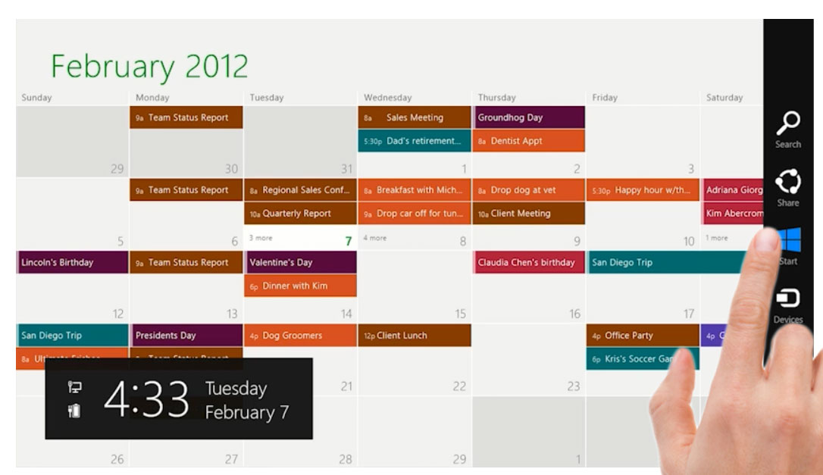
Charms
Charms allow designers to reduce unnecessary elements because charms are in integral part of the Windows 8 UI. Charms include one location where users can change their settings, search and share. Charms allow the designers to build their applications without concerning themselves with integrating those elements into their own application.

Slide 15
Touch language
Touch language is an integral part of a the Windows 8 platform and a new Windows UI style app. Windows 8 provides a concise set of touch interactions that are used consistently throughout the system.
The mouse and keyboard have are fully supported in Windows 8. They are functionally consistent with touch, yet provide the unique and distinctive interaction experiences with which users are familiar.

Slide 16
App bar
The app bar helps you design an app that follows the new Windows UI style concept of doing more with less. The App bar allows you to conceal commands, or features, until they are needed. This allows your users to focus on the task at hand and not commands that don’t apply to their present scenario.
The user accesses the app bar by swiping the bottom edge of the screen and can interact with the content to make app bars disappear. App bars can also be used to show commands or options that are specific to the user's context, such as photo selection or drawing mode.

Slide 17
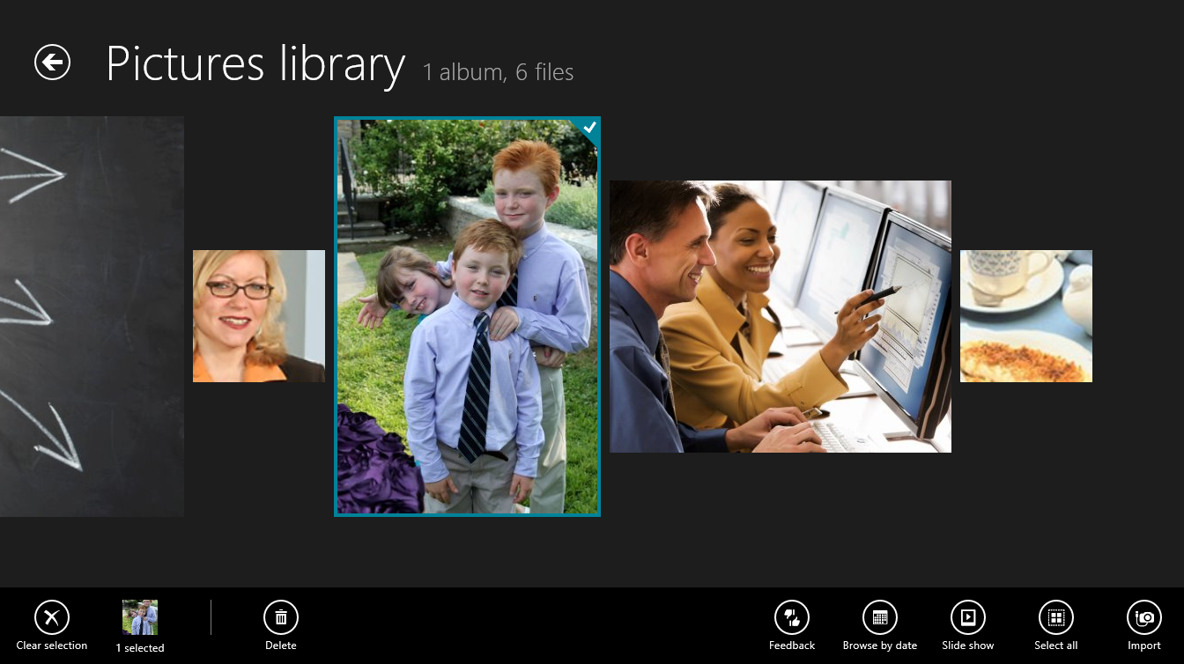
App bar: Controls only when needed
Notes:
The app bar changes depending upon context, such as when an image is selected.

Slide 18

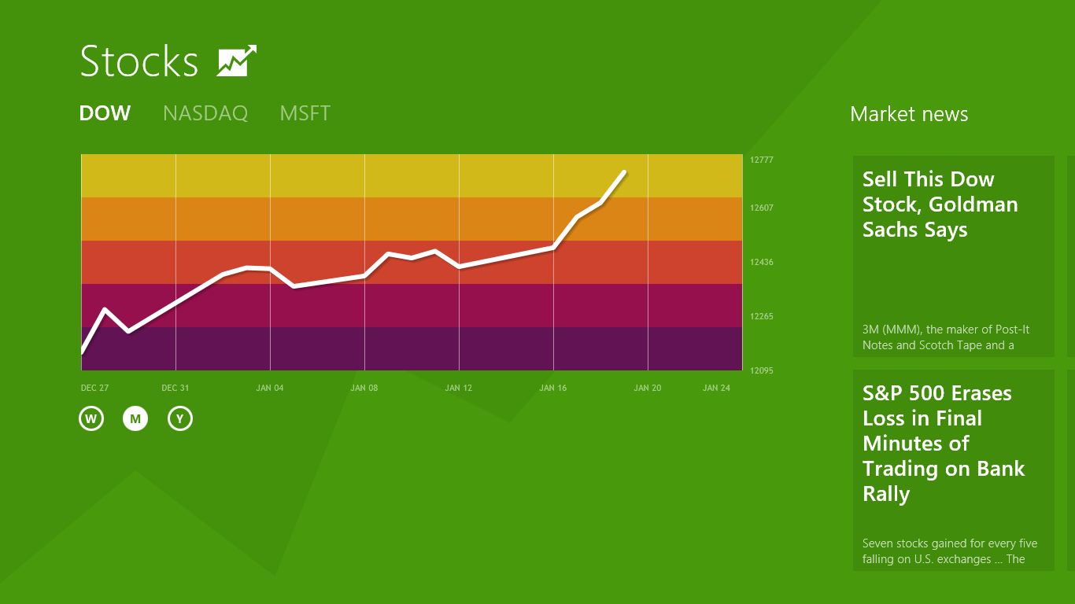
Windows 8 views
A new Windows UI style app contains new views and resolutions that a UX designer might not have had to consider in the past. These include:
Landscape view
Snap view
Portrait view
Notes:
Module 10 is focused on designing apps to be optimized for use in the various views

Slide 19
Summary
This module covered:
Locating and installing applications
Concepts behind new Windows UI style applications
Components of Windows 8 applications
App bar
Views

